Slide 1
Personalized Workout & Diet Planner with AI
CAPSTONE PROJECT
Presented By:
Student Name- Vanapalli Madhu Kishore
College Name- Seshadripuram Degree College
Department- BCA

Slide 2
OUTLINE
Problem Statement (Should not include solution)
Proposed System/Solution
System Development Approach (Technology Used)
Algorithm & Deployment
Result
Conclusion
Future Scope
References

Slide 3
Problem Statement
In today’s world, many people want to stay fit, lose weight, or gain muscle, but most fitness apps provide general plans that are not personalized to individual health conditions.
There is no proper system that combines:
BMI calculation
Activity level
Personal fitness goals
Calorie optimization
Health risk detection
Because of this, users may follow incorrect diet or workout plans that are not safe or effective for their body type.
So, we need an AI-based intelligent fitness system that can analyze a user’s health data and generate a personalized, safe, and optimized workout and diet plan automatically.
.

Slide 4
Proposed Solution
The proposed solution is an intelligent AI-based fitness and diet planning system designed to provide fully personalized health recommendations instead of general advice. The system collects user information such as age, height, weight, activity level, and fitness goals, and then calculates important health indicators like BMI, BMR, TDEE, and target calories. Using a Random Forest machine learning model along with clustering techniques and rule-based decision logic, it classifies users into categories such as underweight, fit, or overweight. Based on this classification, it generates customized workout schedules, diet plans, macro-nutrient distributions, and weekly exercise programs.
In addition to recommendations, the system also performs health risk analysis, calorie optimization, fairness checks, and safety constraint validation to ensure that the advice is medically safe and goal-oriented. It tracks user progress, predicts future weight changes, calculates health scores, and provides confidence levels for its recommendations. The platform includes visual dashboards, KPI monitoring, interactive GUI controls, and automated PDF report generation. Overall, this solution combines machine learning, optimization, explainable AI, and health analytics into one complete, smart fitness decision system suitable for real-world and enterprise-level deployment.

Slide 5
System Approach
The system follows a step-by-step intelligent approach to provide personalized fitness recommendations. First, it collects basic user details such as age, height, weight, activity level, fitness goal, and budget preference. Using this data, it calculates important health metrics like BMI, BMR (Basal Metabolic Rate), TDEE (Total Daily Energy Expenditure), and target daily calories. These calculated values help the system understand the user’s current health condition and energy requirements.
Next, the processed data is given to a machine learning model (Random Forest Classifier) which predicts the user’s fitness category such as underweight, fit, or overweight. The system also uses clustering techniques (K-Means) to segment users into similar groups for better personalization. After classification, rule-based logic and optimization techniques are applied to generate a customized workout schedule, diet plan, weekly program, and macro-nutrient distribution based on the user’s goal.
The system further checks for health risks, applies safety constraints, performs fairness validation, and calculates confidence scores to ensure the recommendations are reliable and safe. It tracks progress, predicts future weight changes, and visualizes results using graphs and dashboards. Finally, the system generates a complete report including health metrics and recommendations, making the entire approach intelligent, structured, transparent, and suitable for real-world application.

Slide 6
Algorithm & Deployment
The system uses a combination of machine learning algorithms and rule-based logic to generate intelligent fitness recommendations. The main algorithm used is the Random Forest Classifier, which analyzes features like age, BMI, activity level, and fitness goals to predict the user’s fitness category. In addition, the K-Means clustering algorithm is used to group users with similar health patterns for better personalization. After prediction, optimization algorithms adjust calorie targets and macro distribution based on goals and health scores. Safety constraints, fairness checks, and decision rules are applied to ensure medically safe and balanced recommendations.
For deployment, the system is developed in Google Colab using Python and can be converted into a web-based application or dashboard. It includes interactive GUI components using ipywidgets, visual analytics using Matplotlib, and automated PDF report generation using ReportLab. The modular structure of the code makes it scalable, explainable, and enterprise-ready, allowing future integration with cloud platforms, mobile apps, or healthcare systems.

Slide 7
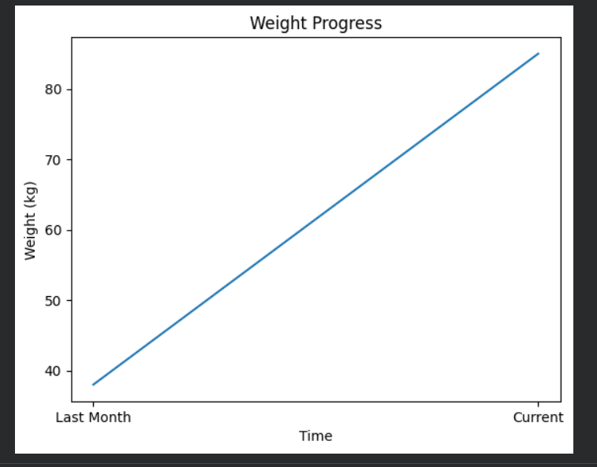
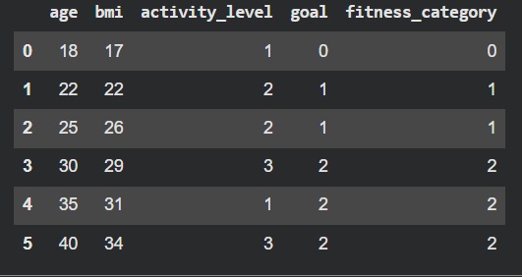
Result

Slide 8
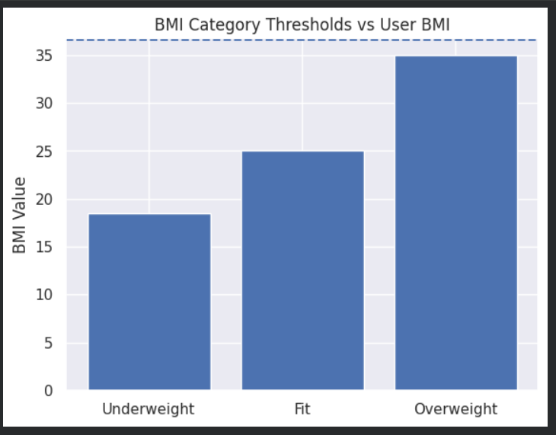
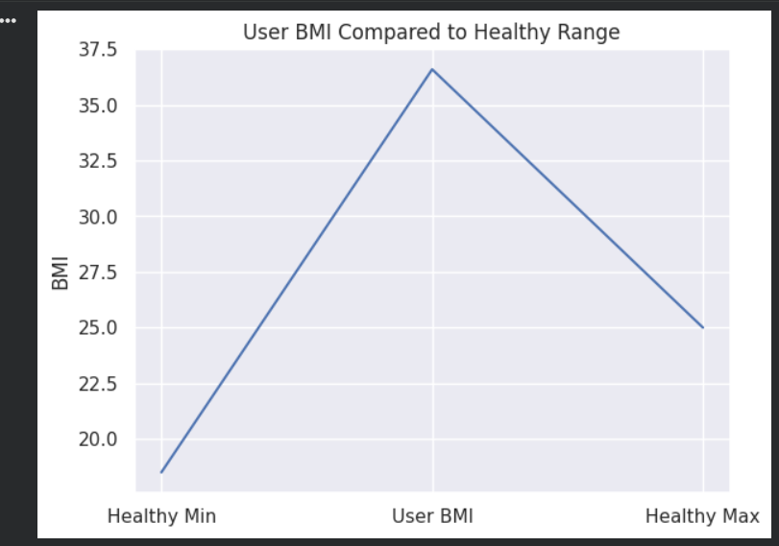
Result

Slide 9
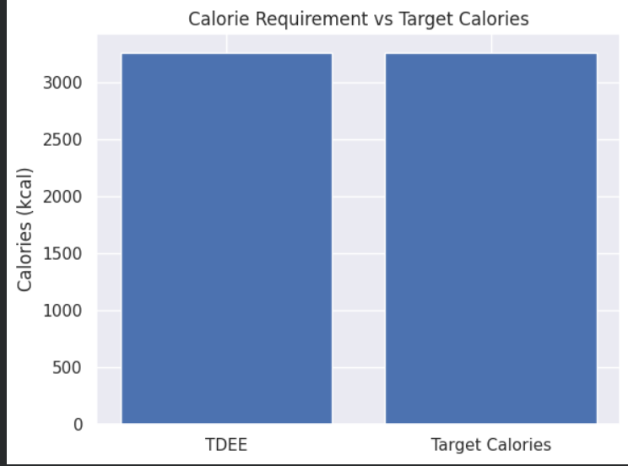
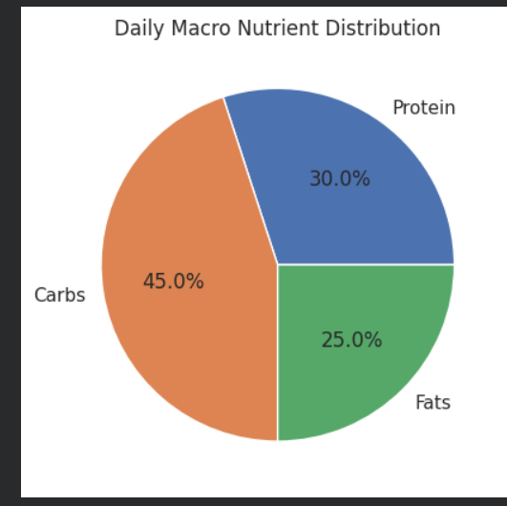
Result

Slide 10
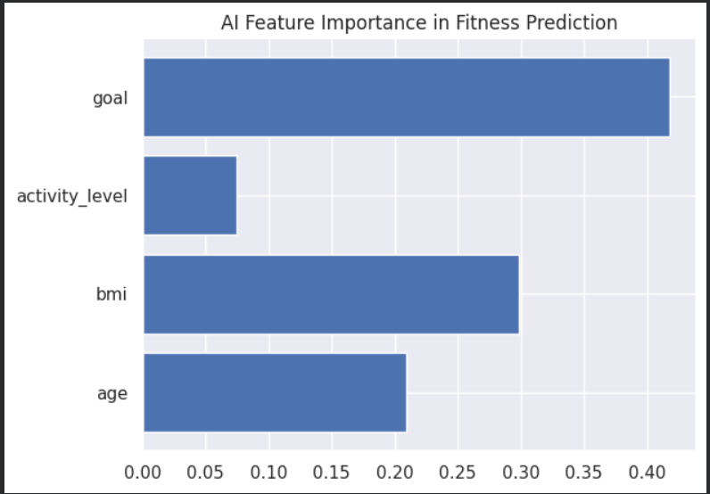
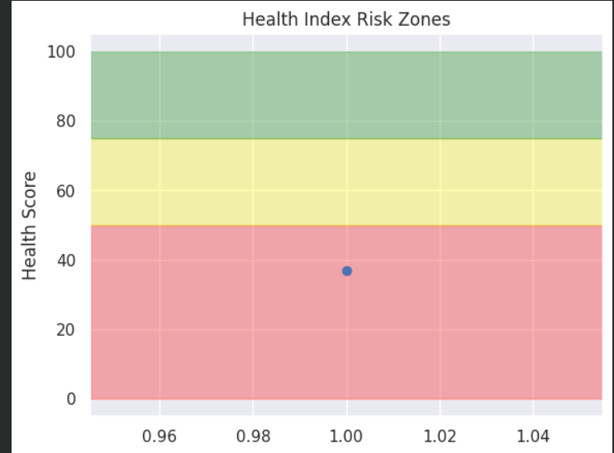
Result

Slide 11
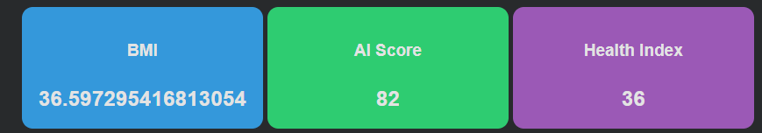
Result

Slide 12
Conclusion
In conclusion, this project shows how artificial intelligence can be effectively applied in the healthcare and fitness domain to create a smart and personalized recommendation system. Instead of giving common or generic advice, the system analyzes individual user data such as age, BMI, activity level, and fitness goals to generate customized workout and diet plans. By combining machine learning algorithms like Random Forest for prediction and K-Means for user segmentation with rule-based logic and optimization techniques, the system ensures that recommendations are both accurate and goal-oriented.
The project also focuses on safety and reliability by including health risk detection, calorie optimization, fairness checks, and constraint validation. It provides explainable outputs, confidence scores, progress tracking, and visual dashboards, making the system transparent and easy to understand. The ability to generate automated PDF reports and interactive GUI dashboards makes it practical for real-world usage. Overall, this project proves that AI can be used to build an intelligent, scalable, and enterprise-ready fitness decision platform that supports better health management and personalized care.

Slide 13
Future scope
Integration with wearable devices (smartwatches, fitness bands) for real-time heart rate, steps, and calorie tracking
Use of larger and real-world healthcare datasets to improve model accuracy
Deployment as a full mobile application (Android & iOS)
Cloud-based storage for user history and long-term tracking
AI chatbot for daily motivation, reminders, and instant fitness advice
Voice assistant support for hands-free interaction
Doctor consultation and medical supervision feature for high-risk users
Integration with gyms, trainers, and nutritionists for expert validation
Personalized push notifications based on user progress
Advanced predictive analytics for long-term weight and health forecasting
Integration with smart kitchen apps for calorie-based meal suggestions
Multi-language support for wider accessibility
Real-time progress comparison with similar user segments
Blockchain-based secure health data storage for privacy protection
Corporate wellness program integration for companies
API integration with hospital management systems
Gamification features like badges, rewards, and fitness challenges
Continuous model retraining to reduce bias and improve fairness
AI-based injury risk prediction and recovery planning
Expansion into a complete AI-powered digital healthcare ecosystem

Slide 14
References
Breiman, L. (2001). Random Forests. Machine Learning Journal.
Scikit-learn Documentation – Random Forest & K-Means Algorithms
Pedregosa et al. (2011). Scikit-learn: Machine Learning in Python. Journal of Machine Learning Research.
World Health Organization (WHO) – BMI Classification Standards
Mifflin, M.D. et al. (1990). A New Predictive Equation for Resting Energy Expenditure (BMR Formula).
Matplotlib & Seaborn Official Documentation
Google Colab Documentation – Python-based ML Development Platform
ReportLab Documentation – PDF Generation in Python
Health & Nutrition Guidelines – National Institute of Nutrition (NIN)
Open-source Python Libraries: Pandas, NumPy Documentation

Slide 15
Github link
Github Link : https://github.com/madhukishore2005/Personalized-Workout-Diet-Planner-with-AI.git

Slide 16
THANK YOU

